Slide 1
Binary Search Tree

Slide 2
Binary Search Tree
BST is a binary tree with following properties:
All items in the left subtree are less than the root
All items in the right subtree are greater than or equal the root
Each subtree is itself a binary search tree
i.e. For a node with key k , every key in the left subtree is less than k and every key in the right subtree is greater than k.
K
<k
>= k

Slide 3
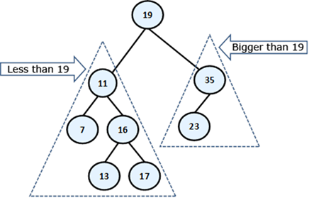
Example of BST

Slide 4
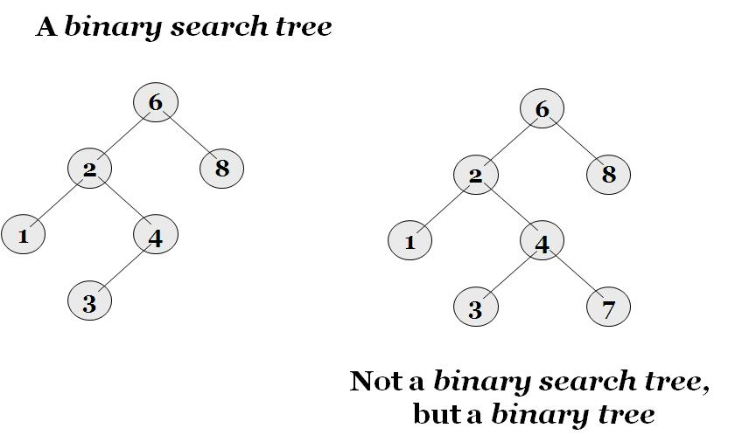
BST vs Binary Tree

Slide 5
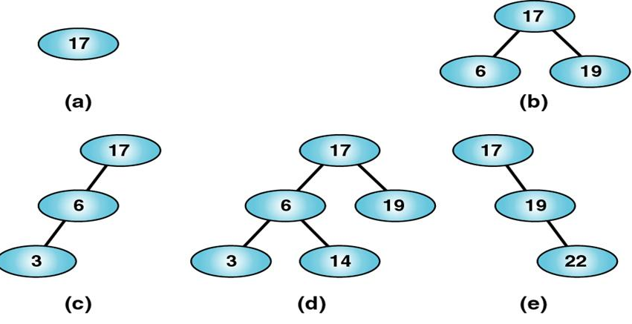
Valid BST

Slide 6
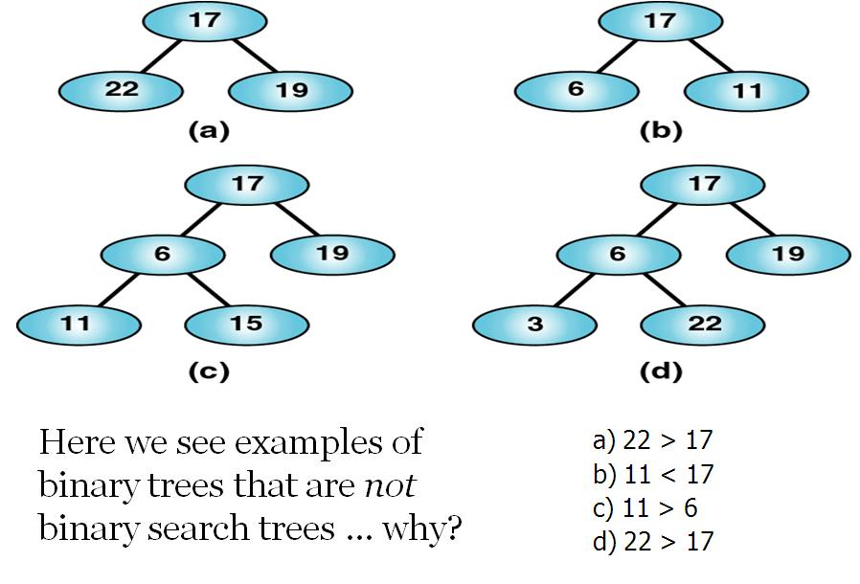
Invalid BST

Slide 7
Operations on Binary Search Trees
Binary trees offer short paths from root. A node has up to two children. Data is organized by value:
Insertion
Search
Traversal
Deletion
Find Minimum: Find the item that has the minimum value in the tree
Find Maximum: Find the item that has the maximum value in the tree
Print: Print the values of all items in the tree, using a traversal strategy that is appropriate for the application
Successor
Predecessor

Slide 8
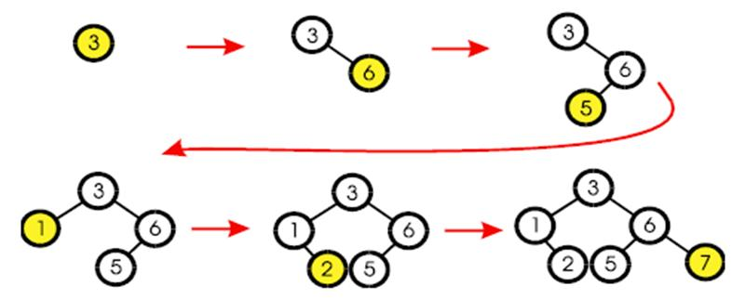
Inserting an item in BST
The first value inserted goes at the root.
Every node inserted becomes a leaf. 
Insert left or right depending upon value.

Slide 9
Insertion
void Insert(struct Node *tree, int item) //’tree’ points to ‘root’
{
if(tree == NULL) { // base case
tree = new Node;
tree->right = NULL;
tree->left = NULL;
tree->data = item;
}
else if(item < tree->data)
Insert(tree->left, item);
else
Insert(tree->right, item);
}

Slide 10
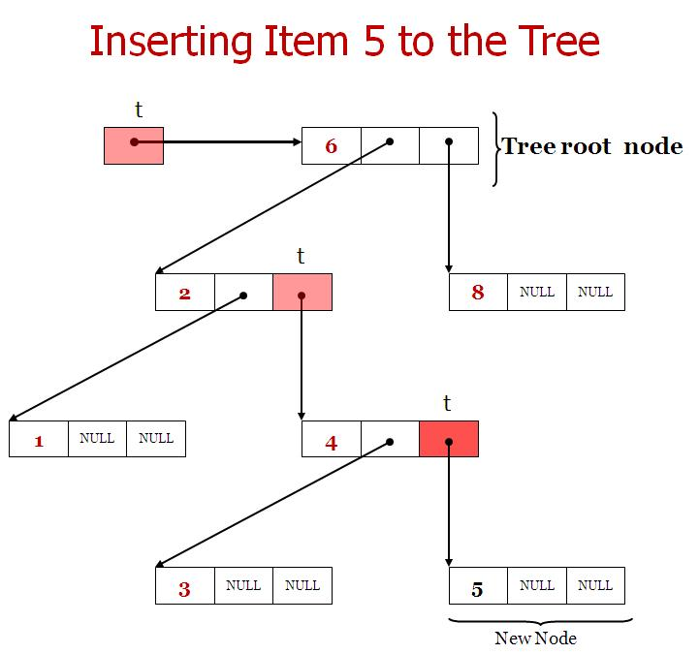
Inserting Specific Item to the tree

Slide 11
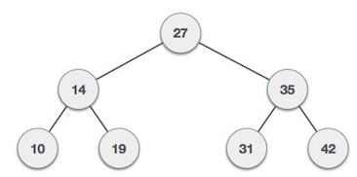
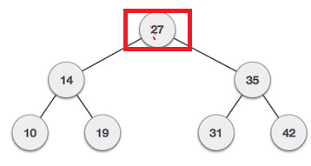
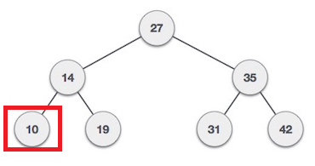
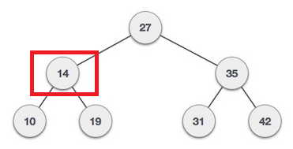
Searching Specific Item to BST
Start search from root node
If data is less than key value, search element in left subtree
Otherwise search element in right subtree.
For Example : we need to search element 10 from the BST

Slide 12
Pseudo code using recursion & without recursion
node *search(struct node* root, int key) { // Base Cases: root is null or key is present at root if (root != NULL) { if( root->key == key) return root; // Key is greater than root's key if (root->key < key) return search(root->right, key); // Key is smaller than root's key return search(root->left, key); } } | search(struct node* root, int data) { struct node *current = root; while(current->data != data) { if(current != NULL) { if(current->data > data) current = current->leftChild; else current = current->rightChild; } } return current; }

Slide 13
Find Smallest Node in BST
Start search from root node
Search element in left subtree
For Example : we need to search element 10 from the BST

Slide 14
Pseudo code using recursion and without recursion
searchmin(struct node* root) { // Base Cases: left subtree is null if (root->left == NULL) return root; return searchmin(root->left); } | minValue(struct node* node) { struct node* current = node; /* loop down to find the leftmost leaf */ while (current->left != NULL) { current = current->left; } return(current->data); }

Slide 15
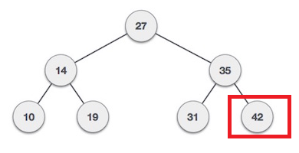
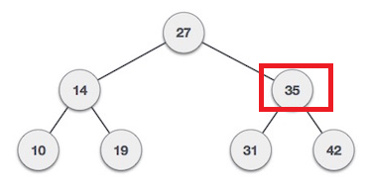
Find Maximum Node in BST
Start search from root node
Search element in right subtree
For Example : we need to search element 10 from the BST

Slide 16
Pseudo code using recursion & without recursion
searchmax(struct node* root) { // Base Cases: right subtree is null if (root->right == NULL) return root->data; return searchmax(root->right); } | maxValue(struct node* node) { struct node* current = node; /* loop down to find the leftmost leaf */ while (current->right!= NULL) { current = current->right } return(current->data); }

Slide 17
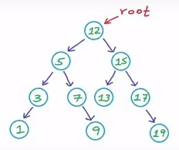
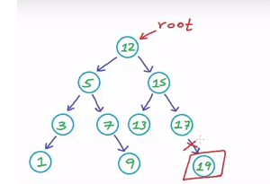
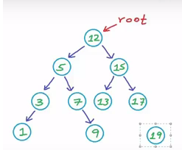
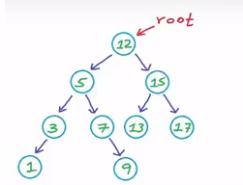
Delete a node from BST
Case 1: leaf node has no child, so this node can easily wiped out from memory
Property of BST must remain

Slide 18
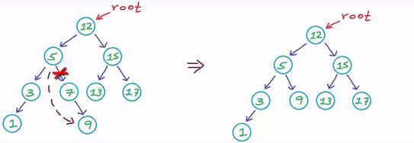
Delete a node from BST
Case 2: if node has one child (left or right ), then link the parent node with the child node and wipe out the node from memory
Property of BST must remain

Slide 19
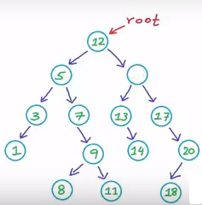
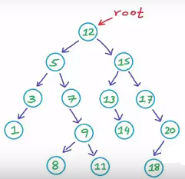
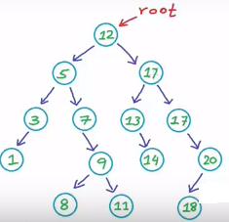
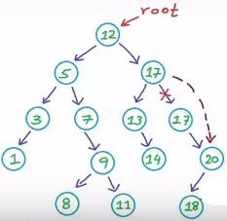
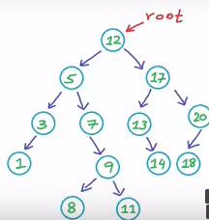
Delete a node from BST
Case 3: if node has two child then two case can be considered:
Find min node from right subtree or max node from left subtree
save the min value in the place of the node deleted
delete the dupicate value
Property of BST must remain

Slide 20
Pseudo code to delete the Node
Node * Delete (Node* root, int data)
{
if(root == NULL) return root;
if (data < root->data) root->left = Delete (root->left , data);
if (data > root->data) root->right= Delete (root->right , data);
else
{
// case 1: no child
if (root ->left == NULL && root->right == NULL)
{delete root; root = NULL; return root;}
// case 2: one child
else if (root ->left == NULL )
{ struct node *temp = root;
root = root->right;
delete temp; return root;
}
else if (root ->right == NULL )
{ struct node *temp = root;
root = root->left;
delete temp; return root;
}
}
}

Slide 21
Pseudo code to delete the Node
Delete (struct node * root, int data)
{
if(root == NULL) return root;
if (data < root->data) root->left = Delete (root->left , data);
if (data > root->data) root->right= Delete (root->right , data);
else
{ // case 3
struct node *temp = findmin( root->right);
root->data = temp->data;
root->right = delete (root->right, temp->data);
return root;
}
}

